Slide 1
Almost everything you need to know about PLS
Part 2: How to perform PLS analyses in Matlab & R
Real Examples
Jenny Rieck & Derek Beaton
21 November 2017

Slide 2
Larger PLS Examples
PLSgui
Block design mean-centered PLS
Face matching in young and old
Demonstrate mean centering options
Event-related behavioral PLS
Incidental memory encoding in young and old
R (via TInPosition & oro.nifti)
Standard, super old school PLS (Tucker, 1958)
Reward cues, genotype, stressors in cannabis users and controls

Slide 3
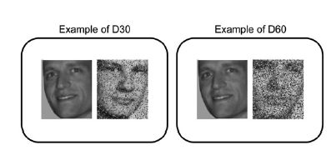
Block Design task-PLS with pslgui
Garrett, McIntosh, & Grady, 2014, Cereb Cortex
N = 40
N = 20 younger adults
N = 20 older adults
Face-matching task
One face degraded 0, 20, 30, 40 ,50 , 60 or 70%
Block Design
5 face-match trials
20 sec fixation

Slide 4
Face-matching task questions
How does brain activity respond to different levels of difficulty of a face matching task?
Focus on condition differences (mean center by group)
How does brain activity at increasing levels of difficulty differ by age group?
Focus on age group differences (mean center by condition)

Slide 5
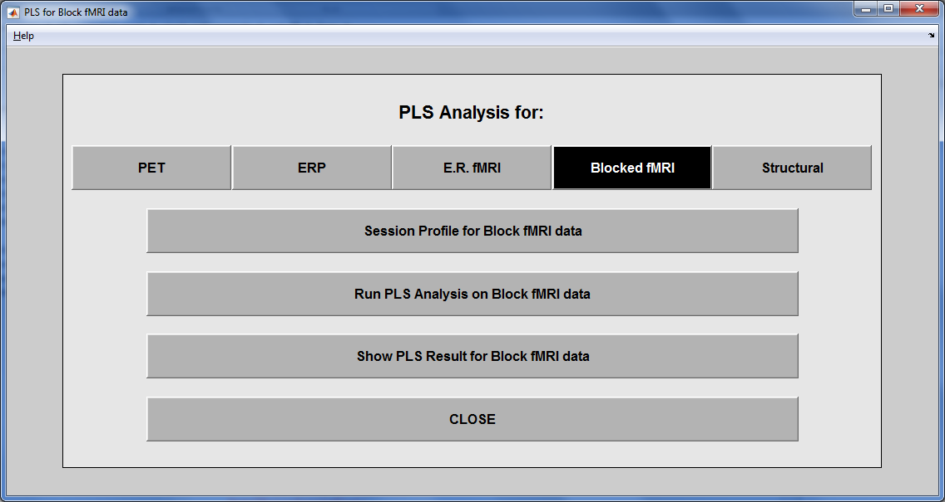
1.
2.
3.

Slide 6
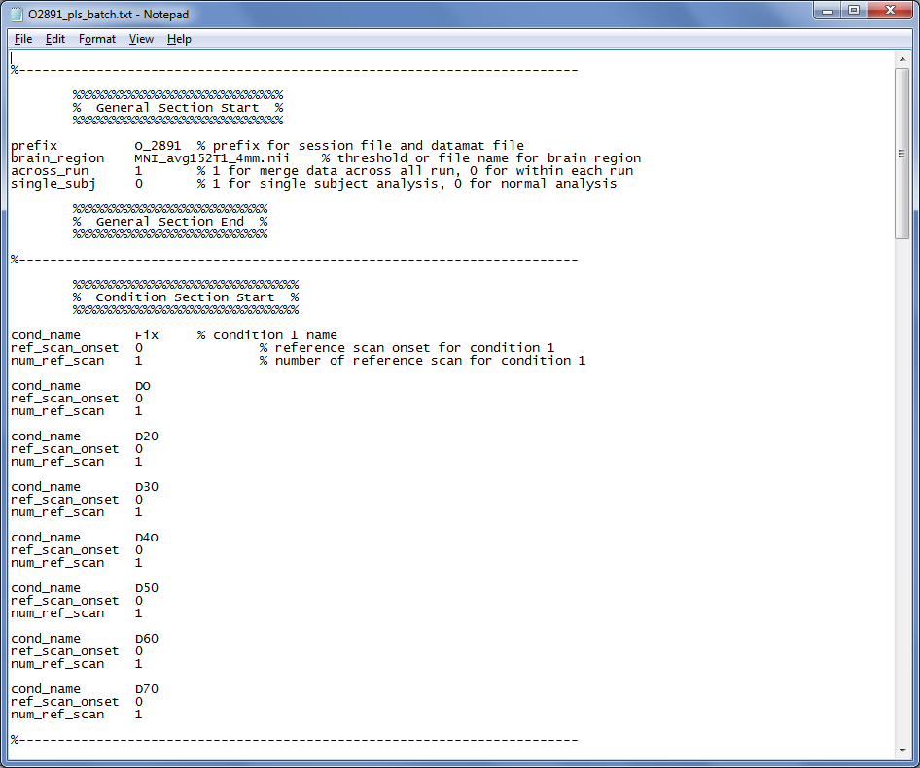
File name and preprocessing specs
PLSgui batch file for block design
“Edit Conditions” specs
Condition names
Ref Scan specs

Slide 7
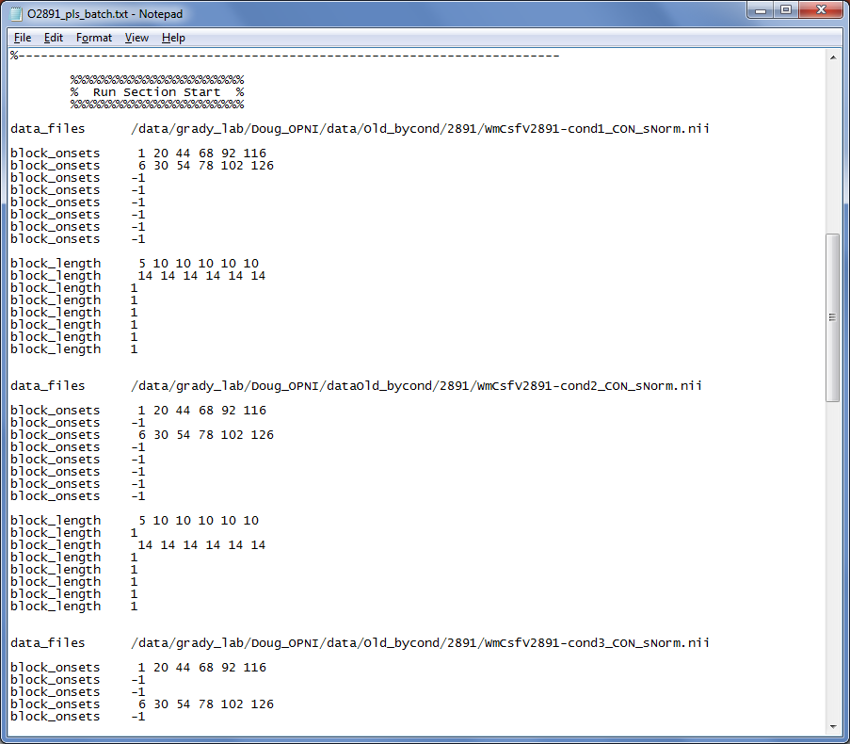
“Edit Runs” specs
Fixation onsets
D0 onset
PLSgui batch file for block design
Fixation Block length
D0 Block length
Fixation onsets
D20 onset
Fixation Block length
D20 Block length

Slide 8
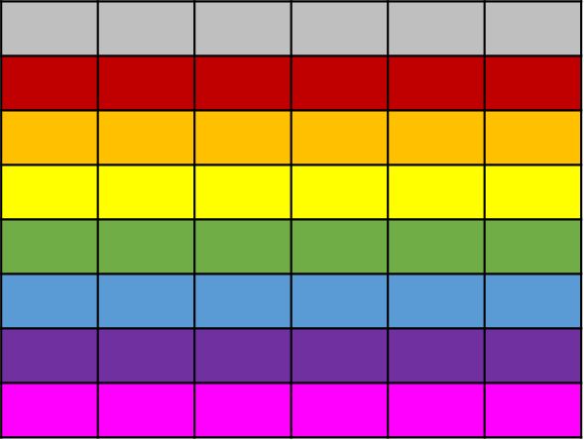
BfMRIsessiondata.mat
Subject O_2891
Voxel₁
Voxel₂
. . . . .
Voxel_{N}
Fixation
0% degradation
20% degradation
30% degradation
40% degradation
50% degradation
60% degradation
70% degradation

Slide 9
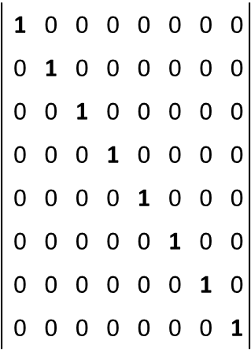
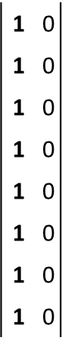
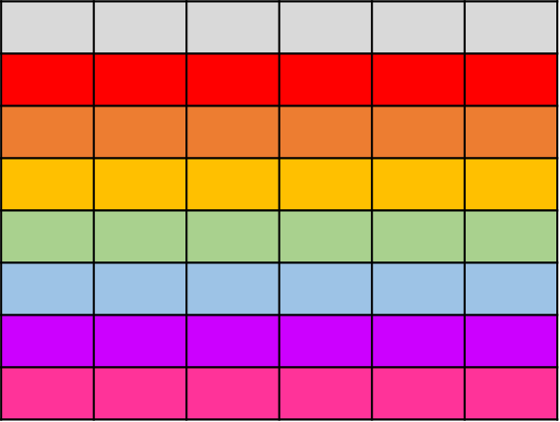
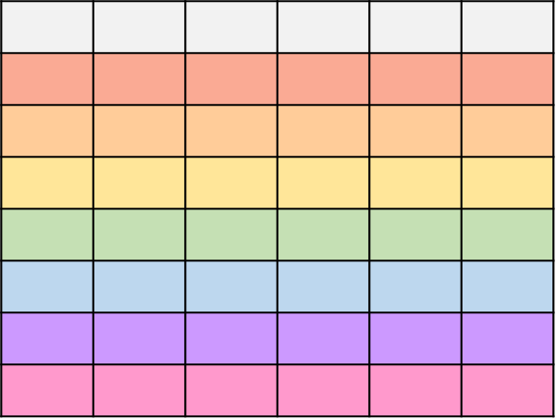
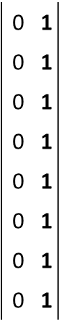
Multi-subject, Multi-Group analysis of block design data
Voxel₁
Voxel₂
. . . . .
Voxel_{N}
Fixation
Young
D20
Old
D30
D40
D50
D60
D0
D70
Subject Y_3224
Subject Y_3767
.
.
.
.
.
.
.
.
.
.
.
.
.
Subject O_980

Slide 10
PLSgui’s 2 matrices
Voxel₁
Voxel₂
. . . . .
Voxel_{N}
D20_{Yng}
D30_{Yng}
D40_{Yng}
D50_{Yng}
D60_{Yng}
D70_{Yng}
D20_{Old}
D30_{Old}
D40_{Old}
D50_{Old}
D60_{Old}
D0_{Yng}
D70_{Old}
Fix_{Yng}
D0_{Old}
Fix_{Old}
Subject Y_3224
Subject Y_3767
.
.
.
.
.
.
.
.
.
.
.
.
.
Subject O_980

Slide 11
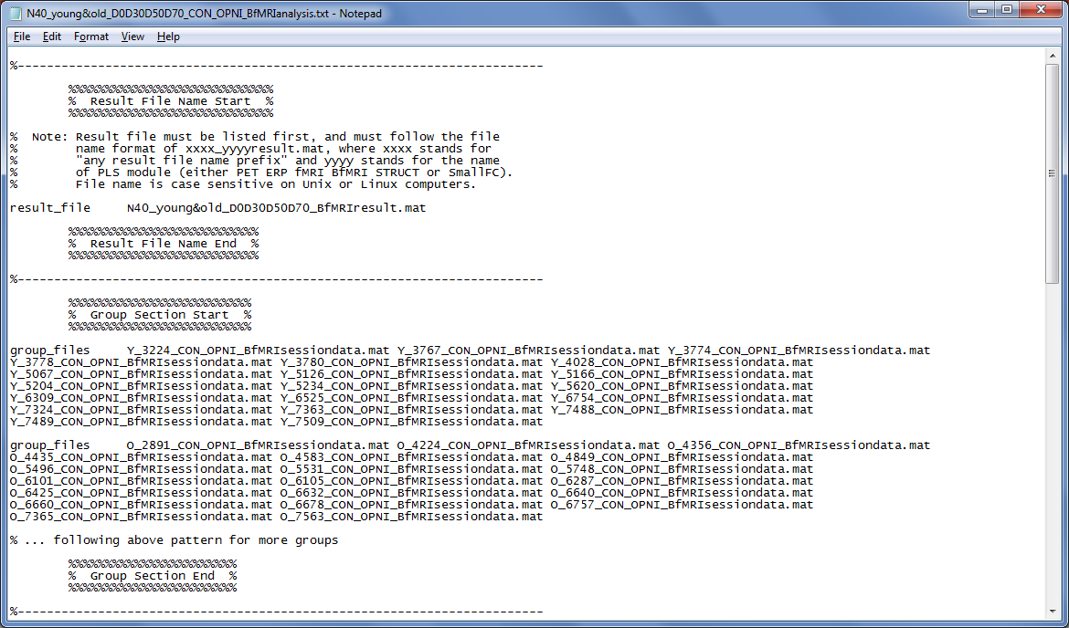
PLSgui batch file for block design analysis
Specify the sessiondata.mat
Young Adult fMRIsessiondata.mat
Older Adult fMRIsessiondata.mat

Slide 12
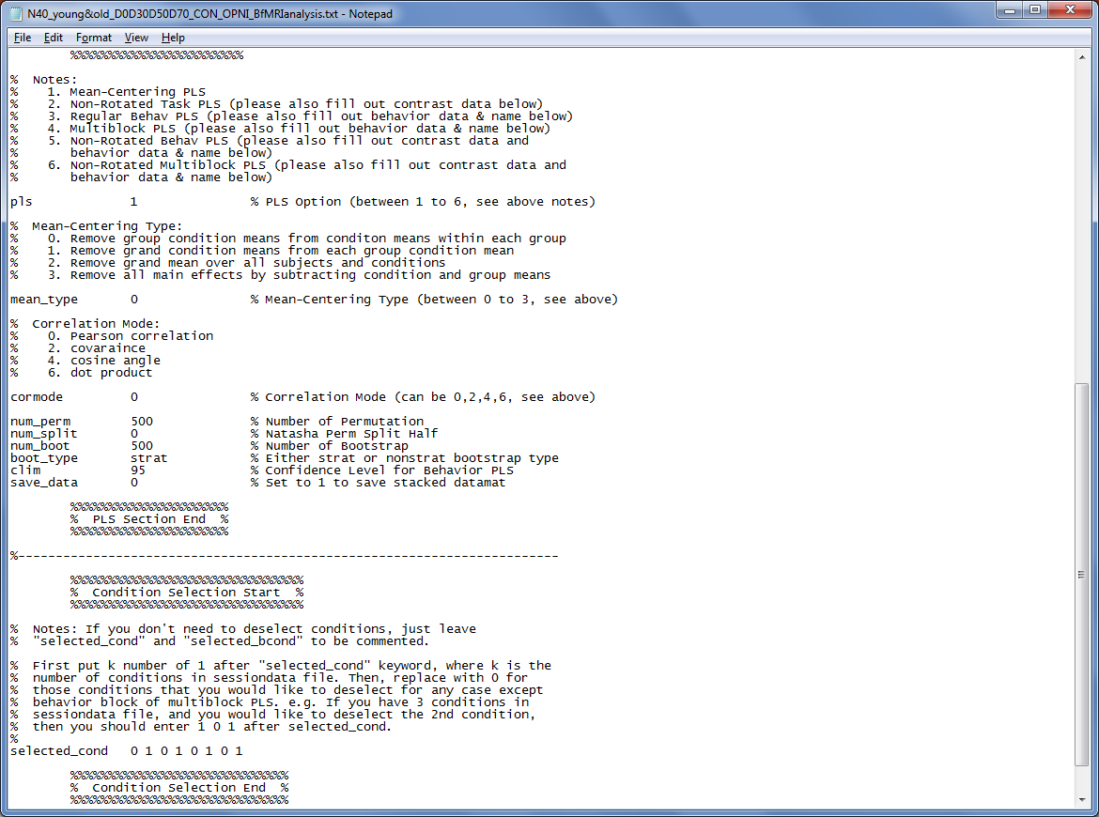
PLSgui batch file for block design analysis
Specify PLS analysis type
Specify mean centering type
Specify resampling
Specify which conditions to analyze

Slide 13
Mean-Center by group (type 0) – boosts condition differences
Voxel₁
Voxel₂
. . . . .
Voxel_{N}
Subject Y_3224
− Young Adult Group Mean
Subject Y_3767
− Young Adult Group Mean
.
.
.
.
.
.
.
.
Subject O_980
− Old Adult Group Mean
Notes:
0 - (default) Within each group remove group means from conditon means. Tells us how conditions are modulated by group membership. Boosts condition differences, removes overall group differences. Best suited if you are interested in condition and condition- by-group effects.
1 - Remove grand condition means from each group condition mean. Tells us how conditions are modulated by group membership. Boosts group differences, removes overall condition differences. Best suited if you are interested in group and group-by-condition effects.
2 - Remove grand mean (over all subjects and conditions). Tells us full spectrum of condition and group effects (group, conditions and group-by-condition).
3 - Remove all main effects, subtract condition and group means (group by condition). This type of analysis will deal with pure group by condition interaction.

Slide 14
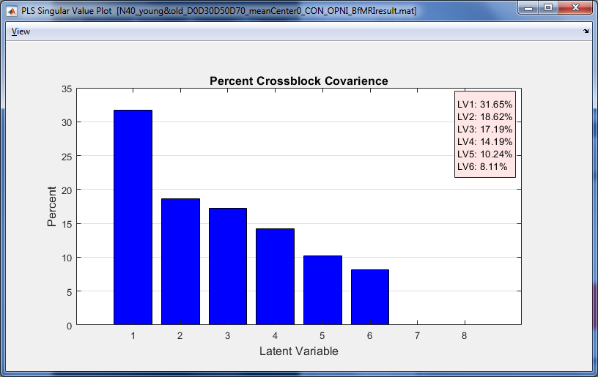
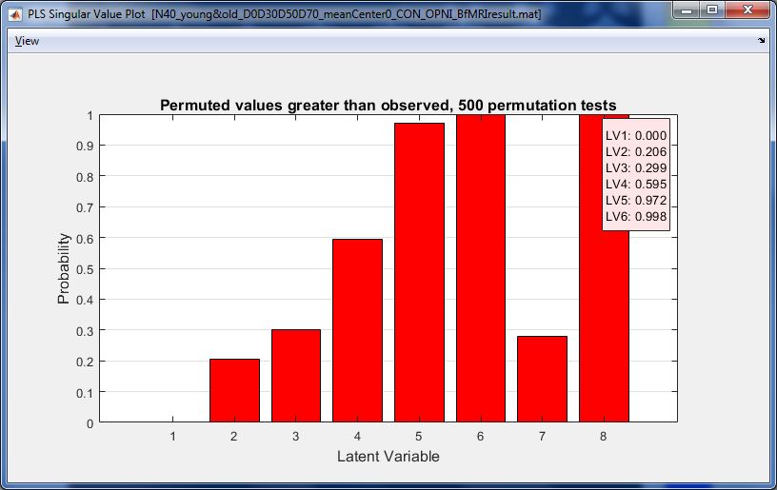
PLS Singular Value Plot
LV 1 explains 31% covariance between task design and activity, p < .002
PLS Singular Value Plot

Slide 15
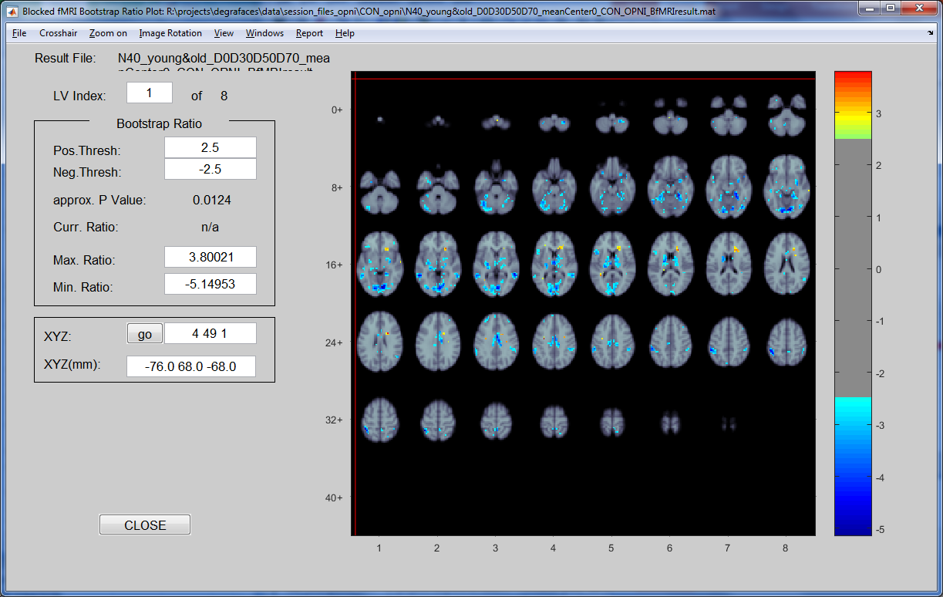
Mean-Center by group (type 0) Significant voxels contributing to LV 1
Set BSR thresholds
Notes:
0 - (default) Within each group remove group means from conditon means. Tells us how conditions are modulated by group membership. Boosts condition differences, removes overall group differences. Best suited if you are interested in condition and condition- by-group effects.

Slide 16
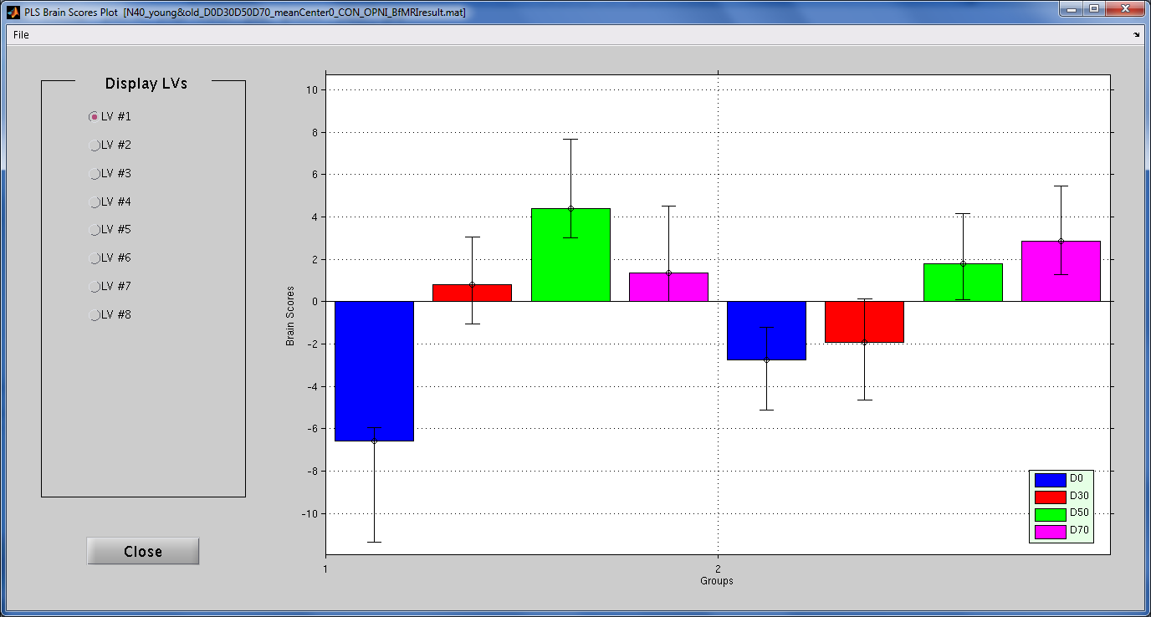
Mean-Center by group (type 0) Significant conditions contributing to LV 1
PLS Brain Scores Plot
D0 vs D50
D0 vs D70
Young Adults
Older Adults

Slide 17
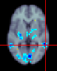
Interpreting fMRI-condition relationships
How does activation for each condition map onto the LV?
Negative BSRs
Design Scores for Young
Notes:
48 -48 4 – middle temporal

Slide 18
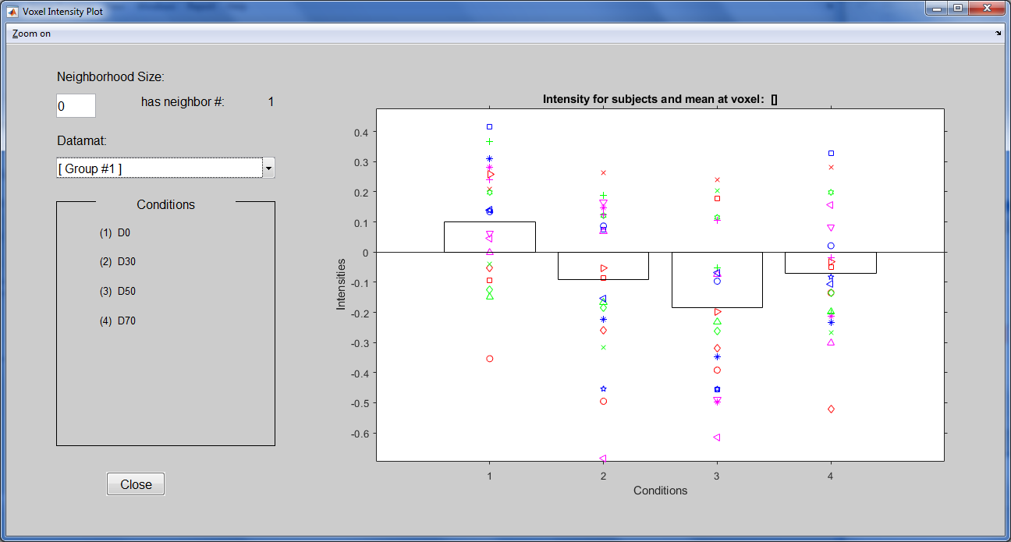
Interpreting fMRI-condition relationships
How does activation for each condition map onto the LV?
Negative BSRs
Design Scores for Young
Voxel Intensity Plot
Mean % signal change
in selected voxel (L middle temporal) for young adults across the 4 conditions
Notes:
Voxel Intensity Plot
48 -48 4 – middle temporal

Slide 19
Interpreting fMRI-condition relationships
Negative BSR & Negative design score indicates a positive relationship
Negative BSRs
Design Scores for Young
Voxel Intensity Plot
Mean % signal change
in selected voxel (L middle temporal) for young adults across the 4 conditions
Notes:
48 -48 4 – middle temporal

Slide 20
Interpreting fMRI-condition relationships
Negative BSR &
Positive design score indicates a negative relationship
Negative BSRs
Design Scores for Young
Voxel Intensity Plot
Mean % signal change
in selected voxel (L middle temporal) for young adults across the 4 conditions
Notes:
48 -48 4 – middle temporal

Slide 21
Mean-Center by condition (type 1) – boosts group differences
Voxel₁
Voxel₂
. . . . .
Voxel_{N}
Subject Y_3224
− Grand Condition Mean
Subject Y_3767
− Grand Condition Mean
.
.
.
.
.
.
.
.
Subject O_980
− Grand Condition Mean
Notes:
1 - Remove grand condition means from each group condition mean. Tells us how conditions are modulated by group membership. Boosts group differences, removes overall condition differences. Best suited if you are interested in group and group-by-condition effects.
0 - (default) Within each group remove group means from conditon means. Tells us how conditions are modulated by group membership. Boosts condition differences, removes overall group differences. Best suited if you are interested in condition and condition- by-group effects.
2 - Remove grand mean (over all subjects and conditions). Tells us full spectrum of condition and group effects (group, conditions and group-by-condition).
3 - Remove all main effects, subtract condition and group means (group by condition). This type of analysis will deal with pure group by condition interaction.

Slide 22
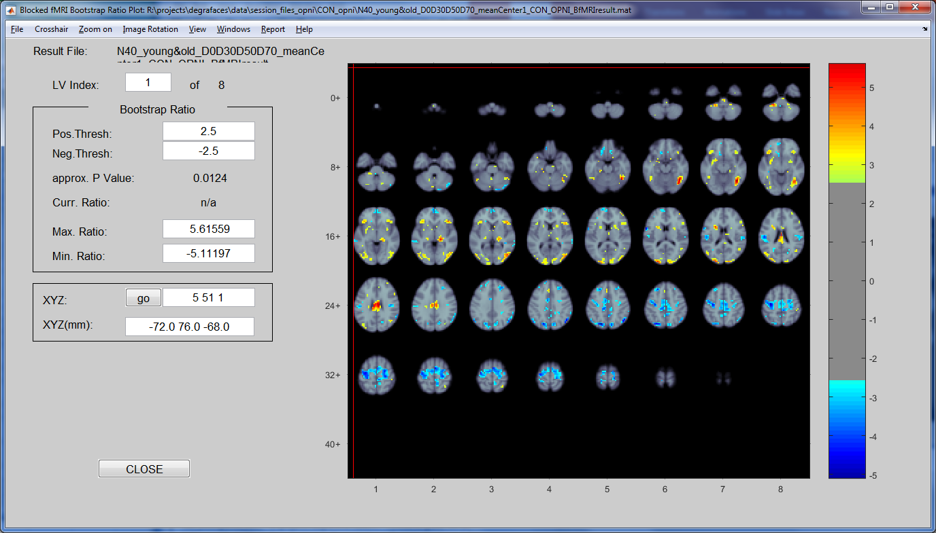
Mean-Center by condition (type 1) Significant voxels contributing to LV 1

Slide 23
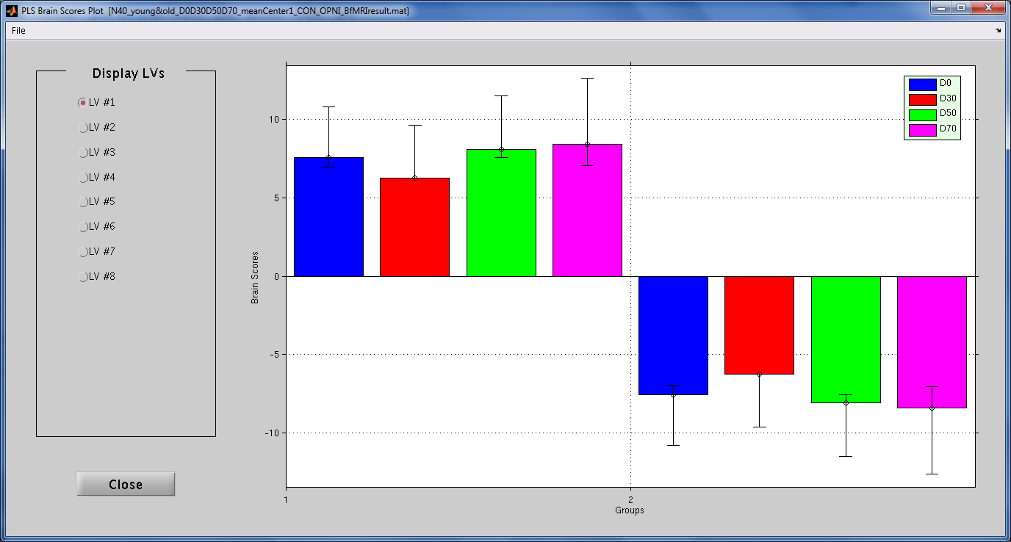
Mean-Center by condition (type 1) Significant conditions contributing to LV 1
PLS Brain Scores Plot
Young vs Old
Young Adults
Older Adults

Slide 24
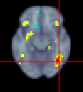
Interpreting fMRI-condition relationships
How does activation for each condition/group map onto the LV?

Slide 25
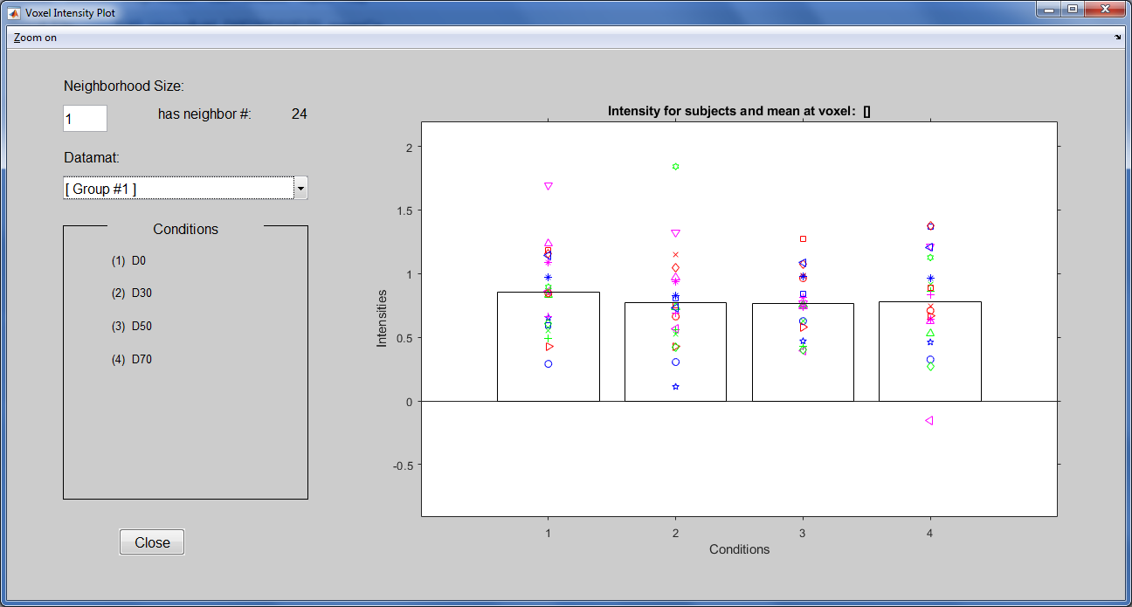
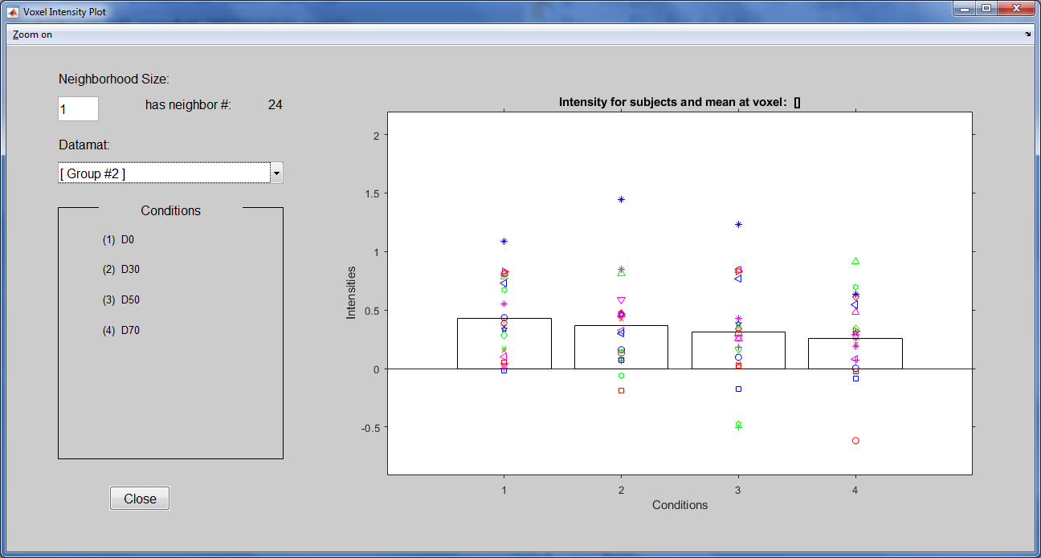
Interpreting fMRI-condition relationships
How does activation for each condition/group map onto the LV?
Younger Adults
Older Adults
Voxel Intensity Plot
Voxel Intensity Plot

Slide 26
Block Design task-PLS Summary
PLS is powerful for block design
Nature of the hemodynamic response
Allows you to analyze condition and/or group differences
BUT be mindful of mean centering options
Different centering techniques can boost group vs condition differences

Slide 27
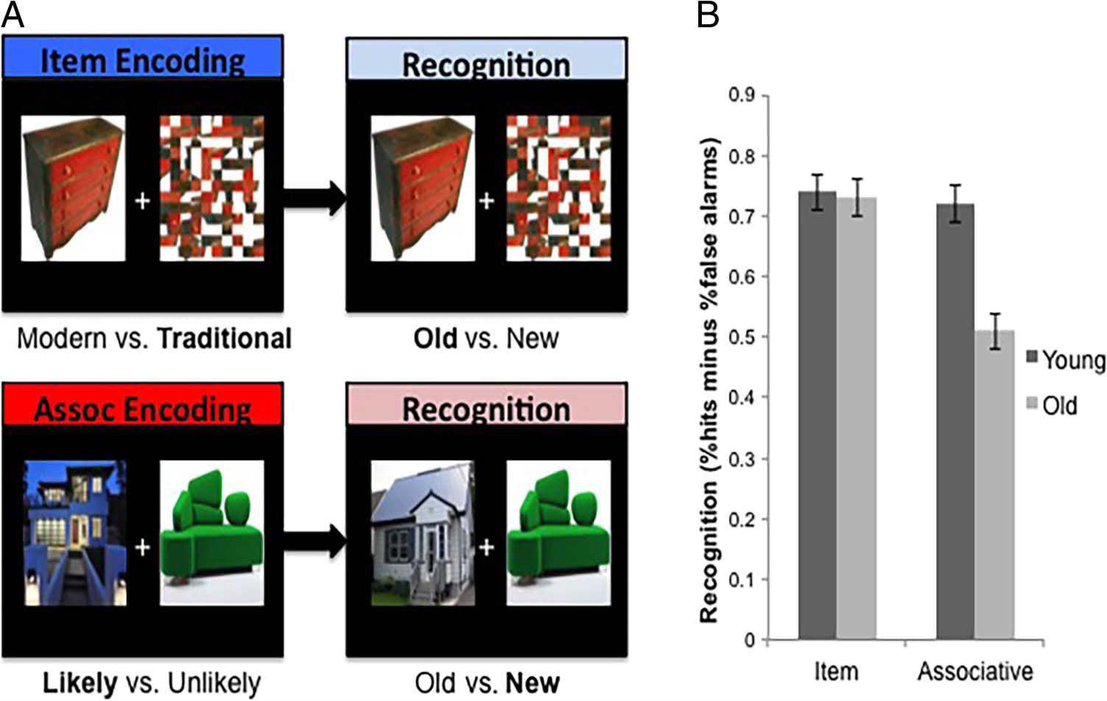
Event-Related Behavioral PLS
Saverino et al., 2016, J Cog Neurosci
N = 31 participants
N = 15 Younger Adults
N = 16 Older Adults
Incidental encoding
Surprise Recognition
Performance as:
Hits – False Alarms
In-Scanner Encoding
Out-of-Scanner Recognition
Modern vs.
Traditional
Old vs. New
Likely vs.
Unlikely

Slide 28
Memory encoding task questions
What profile of activity during incidental item and paired associates encoding is correlated with better subsequent memory?
How do brain-behavior relationships differ between young and older adults?

Slide 29
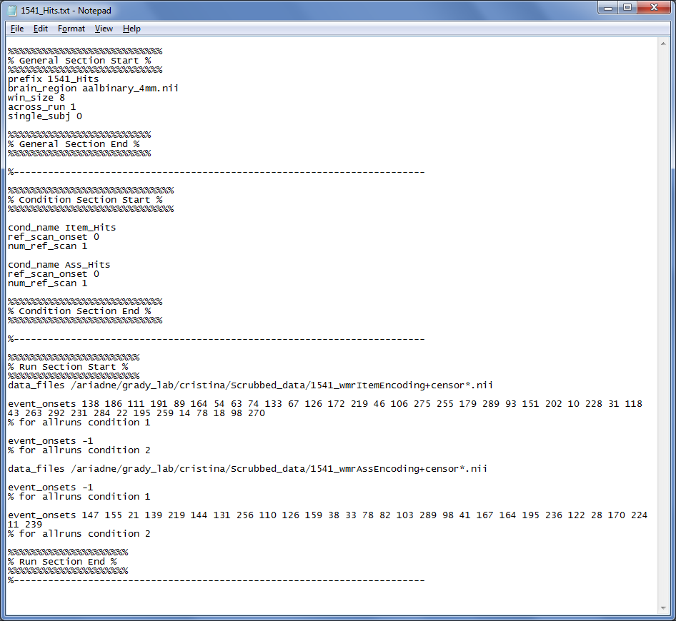
File name and preprocessing specs
win_size = size of hemodynamic period to model
PLSgui batch file for event-related design
“Edit Conditions” specs
Condition names
Ref Scan specs
“Edit Runs” specs
Data files
Event Onsets
Onsets for Item Hits
Onsets for Associative Hits
Notes:
win_size indicates the number of scans in one hemodynamic period.

Slide 30
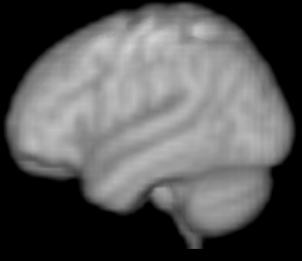
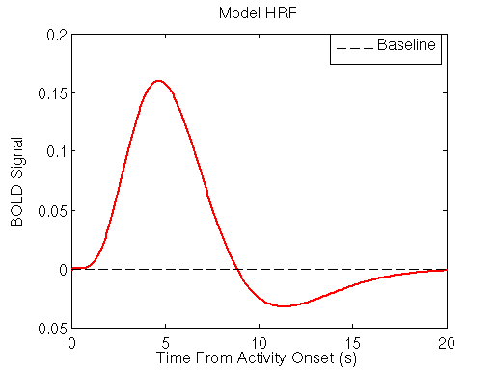
. . . . .
Item Hit (aka subsequently remembered)

Slide 31
. . . . .
Item Hit (aka subsequently remembered)

Slide 32
Item Hit (aka subsequently remembered)
voxel 1
voxel 2

Slide 33
. . . . .
Item Hit (aka subsequently remembered)
voxel 1
voxel 2
Item Hit Red Dresser

Slide 34
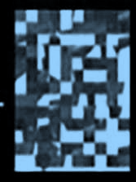
. . . . .
Item Hit (aka subsequently remembered)
voxel 1
voxel 2
Item Hit Red Dresser
Item Hit Blue House

Slide 35
. . . . .
Item Hit (aka subsequently remembered)
voxel 1
voxel 2
Item Hit Red Dresser
Item Hit Blue House

Slide 36
. . . . .
Item Hit (aka subsequently remembered)
Item Hit (aka subsequently remembered)
voxel 1
voxel 2
Item Hit Red Dresser
Item Hit Blue House

Slide 37
fMRIsessiondata.mat
voxel 1
voxel 2
voxel N
Item Hit #1
. . .
. . .
Item Hit #2
. . .
. . .
Item Hit #N
. . .
. . .
Associative Hit #1
. . .
. . .
Associative Hit #N
. . .
. . .
Lag 0
Lag 1
Lag 2
Lag 3
. . .
. . .
Lag 4
Lag 0
Lag 1
Lag 2
Lag 3
Lag 4
Lag 2
Lag 3
Lag 4

Slide 38
fMRIsessiondata.mat
Voxel_{N} Lag2
Voxel_{N} Lag3
Voxel₁ Lag0
Voxel_{N} Lag4
Voxel₁ Lag1
Voxel₁ Lag2
Voxel₁ Lag3
Voxel₁ Lag4
Voxel₂ Lag0
Voxel₂ Lag1
Voxel₂ Lag2
Voxel₂ Lag3
Voxel₂ Lag4
Mean Item Hits
. . .
Mean Assoc. Hits
. . .

Slide 39
Multi-subjects, Multi-groups
Voxel_{N} Lag2
Voxel_{N} Lag3
Voxel₁ Lag0
Voxel_{N} Lag4
Voxel₁ Lag1
Voxel₁ Lag2
Voxel₁ Lag3
Voxel₁ Lag4
Voxel₂ Lag0
Voxel₂ Lag1
Voxel₂ Lag2
Voxel₂ Lag3
Voxel₂ Lag4
Young₁ Item Hits
. . .
Young₁ Assoc Hits
. . .
Young₂ Item Hits
. . .
Young₂ Assoc Hits
. . .
.
.
Old₁₆ Item Hits
. . .
Old₁₆ Assoc Hits
. . .

Slide 40
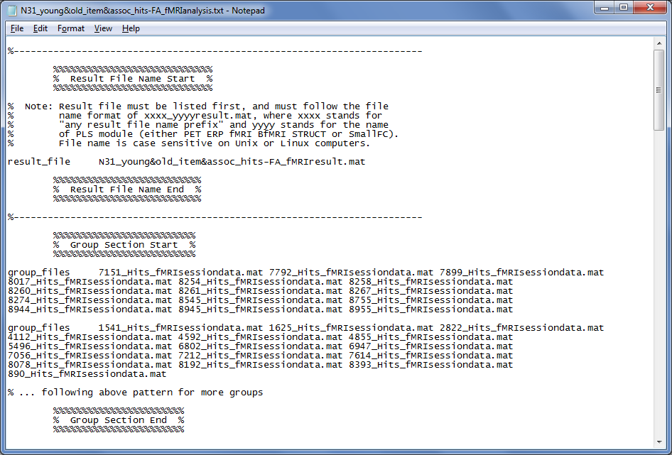
PLSgui batch file for event-related behavioral analysis
Specify the sessiondata.mat
Young Adult fMRIsessiondata.mat
Older Adult fMRIsessiondata.mat

Slide 41
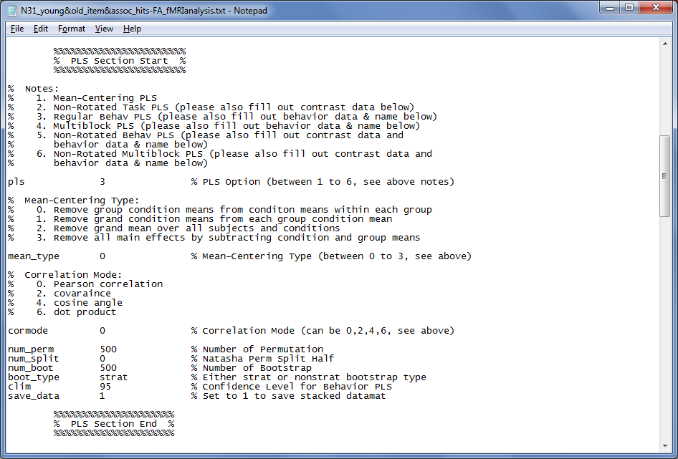
PLSgui batch file for event-related behavioral analysis
Specify PLS analysis type

Slide 42
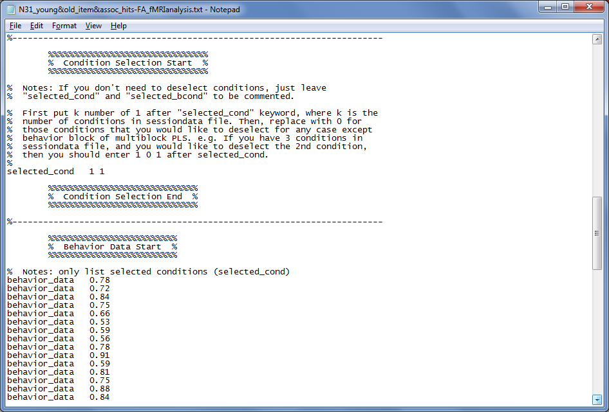
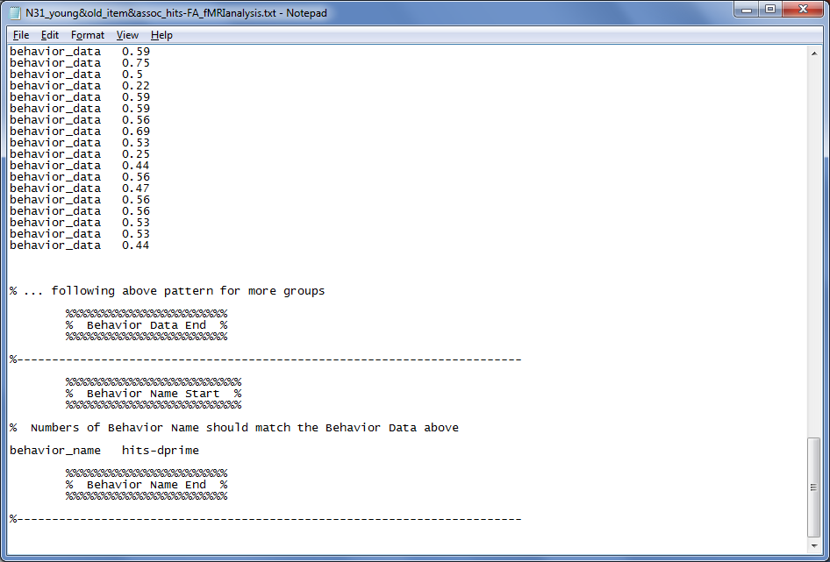
PLSgui batch file for event-related behavioral analysis
Specify which conditions to analyze
rows should be arranged in the order of
subjects in selected conditions in groups
group1 condition1 subject1
group1 condition1 subject2
group1 condition2 subject1
group1 condition2 subject2
group2 condition1 subject1
group2 condition1 subject2
group2 condition1 subject3
group2 condition2 subject1
group2 condition2 subject2
group2 condition2 subject3
Young₁ ItemScore
⁞
Young₁₅ ItemScore
Young₁ AssocScore
⁞
Young₁₅ AssocScore
Old₁ ItemScore
⁞
Old₁₆ AssocScore
Notes:
rows should be arranged in the order of subjects in selected conditions in groups

Slide 43
PLSgui’s 2 matrices
Voxel_{N} Lag5
MemoryScore
Voxel_{N} Lag6
Voxel₁ Lag0
Voxel_{N} Lag7
Voxel₁ Lag1
Voxel₁ Lag2
Young₁ Item Hits
. . .
.78
Young₂ Item Hits
. . .
.72
.
.
.
.
Young₁ Assoc. Hits
. . .
.65
.
.
.
.
. . .
Young₁₅ Assoc Hits
.78
Old₁ Item Hits
. . .
.82
.
.
.
.
Old₁₆ Assoc Hits
. . .
.62

Slide 44
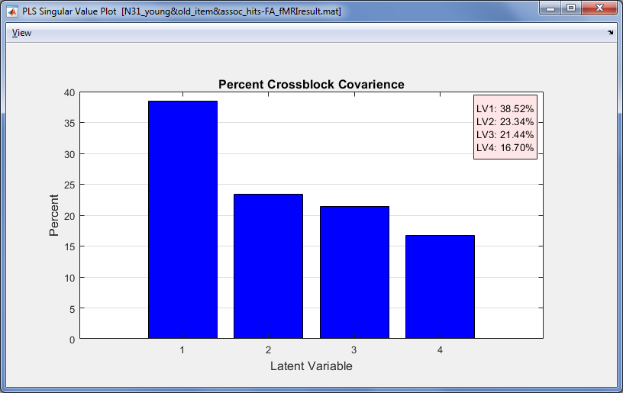
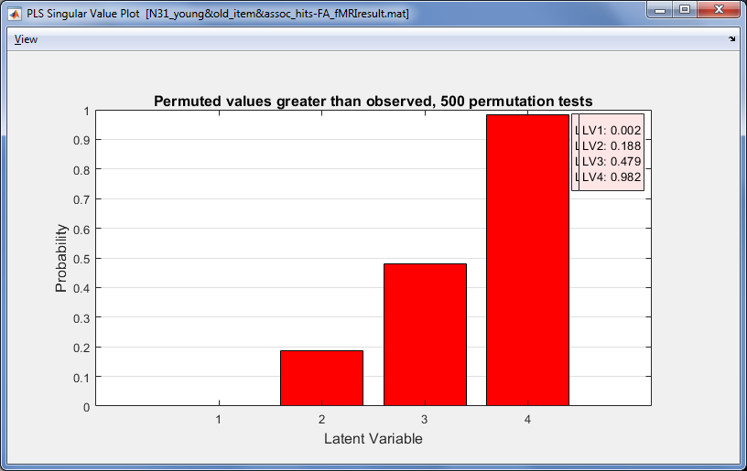
LV 1 explains 38.5% covariance between task performance and brain activity, p = .002

Slide 45
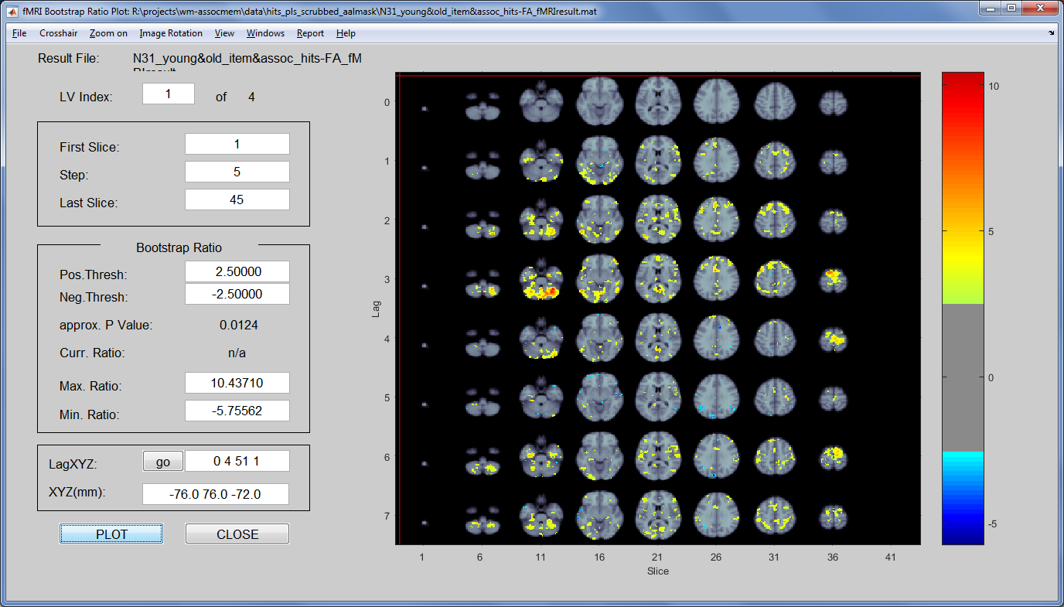
Significant voxels contributing to LV 1

Slide 46
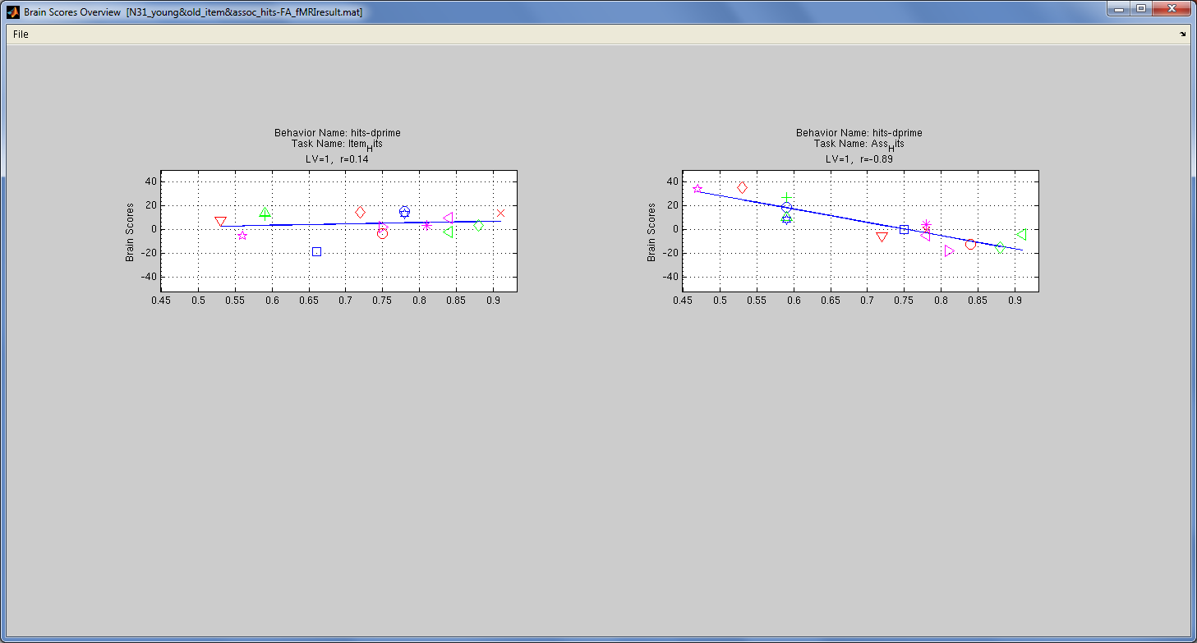
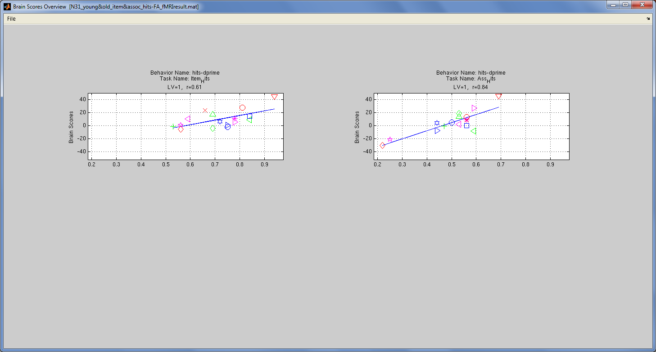
Correlations between behavior and activity on LV1
Plot Brain Scores Overview
Younger Adults
ItemScore
AssociativeScore
Older Adults
ItemScore
AssociativeScore

Slide 47
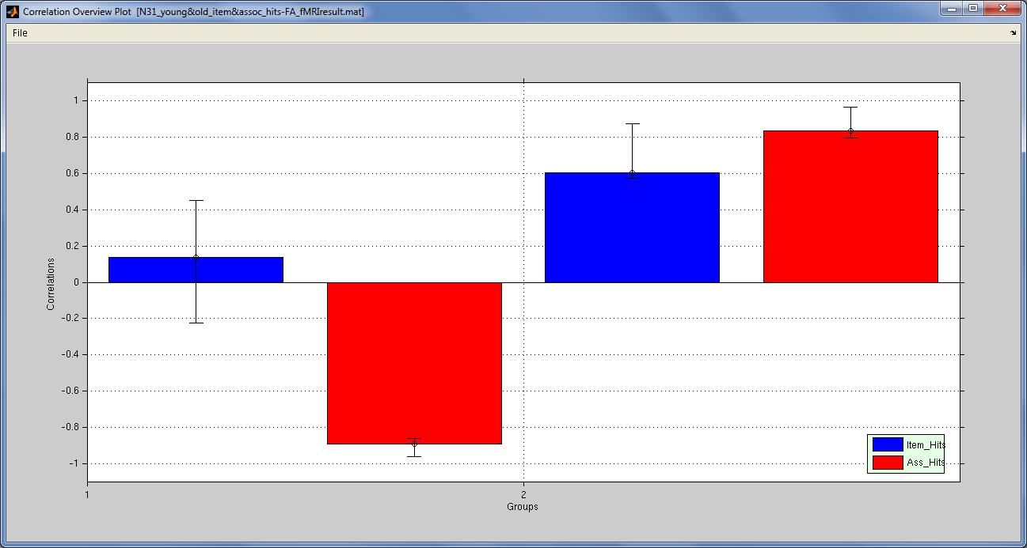
Significant Brain-Behavior correlations contributing to LV 1
Plot Brain Scores Overview
> Correlation Overview Plot
Young Adults
Older Adults

Slide 48
Interpreting Brain-Behavior correlations
Correlations between behavior & BrainScores
Young Adults
Older Adults
Young Adults show a negative correlation between Associative Memory Scores and Brain Scores
Increased associative memory performance is correlated with decreased activity during encoding in hot regions

Slide 49
Interpreting Brain-Behavior correlations
Correlations between behavior & BrainScores
Young Adults
Older Adults
Older Adults show a positive correlation between
Item and Associative Memory Scores and Brain Scores
Increased item and associative memory performance is correlated with increased activity during encoding in hot regions

Slide 50
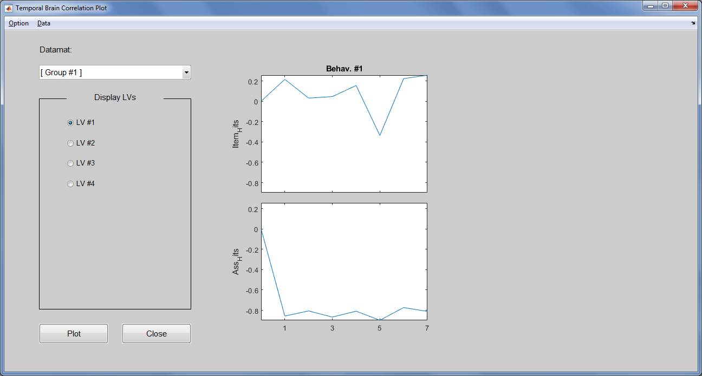
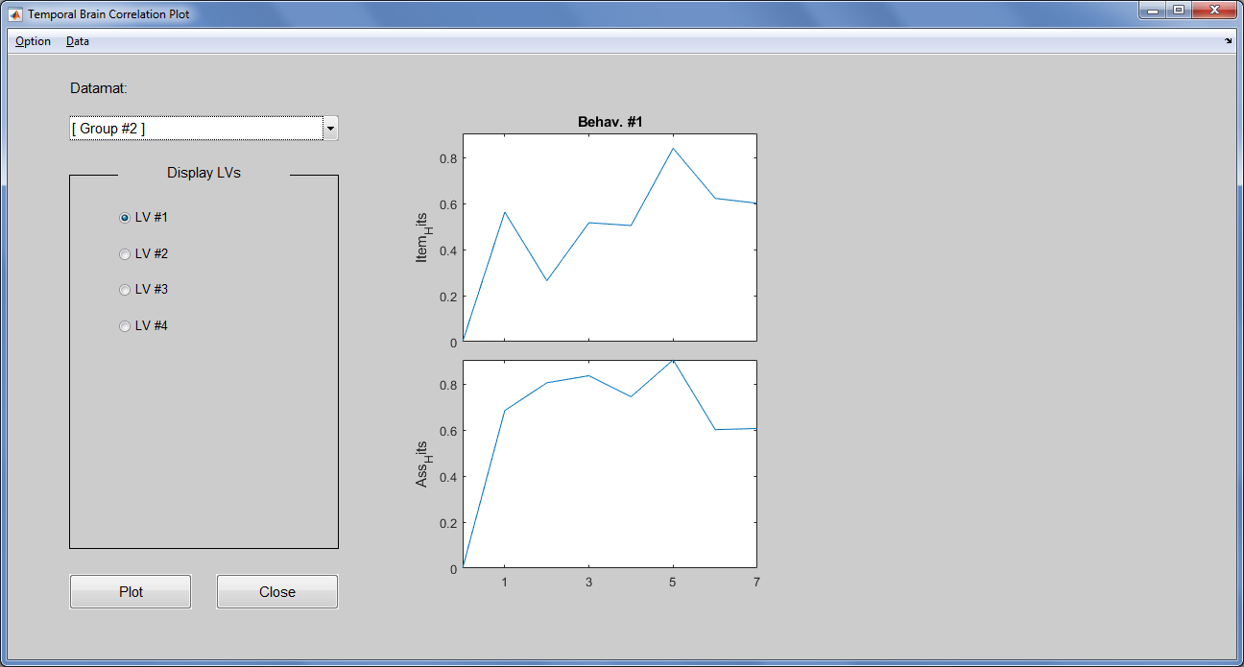
Examining the TimeCourse of the brain-behavior relationships
Temporal Brain Correlation Plot
Young Adults
Older Adults
Temporal Lag
Temporal Lag

Slide 51
Event-Related Behavioral PLS Summary
Way to examine behavioral (or other) correlates of activity patterns in relation to task design/participant groups
More to interpret with event-related designs
BUT can examine how brain-behavior relationships change over time (i.e., hemodynamic response)

Slide 52
Now onto R

Slide 53
Reward, genes, and stress
Motivation
Study reward processing in substance use disorders
Known differences in groups (Filbey et al., 2016)
Design and set up
N = 128: 56 chronic cannabis users, 72 controls
Work with Filbey lab (UTD)

Slide 54
Design and set up
N = 128: 56 chronic cannabis users, 72 controls
Visual and tactile cues:
Marijuana pipe
Appetitive cue (favorite fruit)
Pencil (neutral)
Subjects also have
FAAH & CNR1 genotype data
Perceived and early (childhood) stress measures

Slide 55
Question:
Broadly:
How do genetics and stress contribute to reward processing in MJ and CON?
Specifically:
What is the relationship between
[Group, Genes, Stress] x [Pipe > Fruit Reward Response]

Slide 56
For PLS
A different approach: use contrasts
Akin to Rissman et al., (2004), St-Laurent et al., (2015)
See also Mumford et al., (2011) for comparisons
Contrast of interest: Pipe > Fruit
Individual (first) level from each subject
Via FSL
Common (MNI) space
Each person has:
Pipe > Fruit Contrast
Belongs to one group, two genes, two stress measures

Slide 57
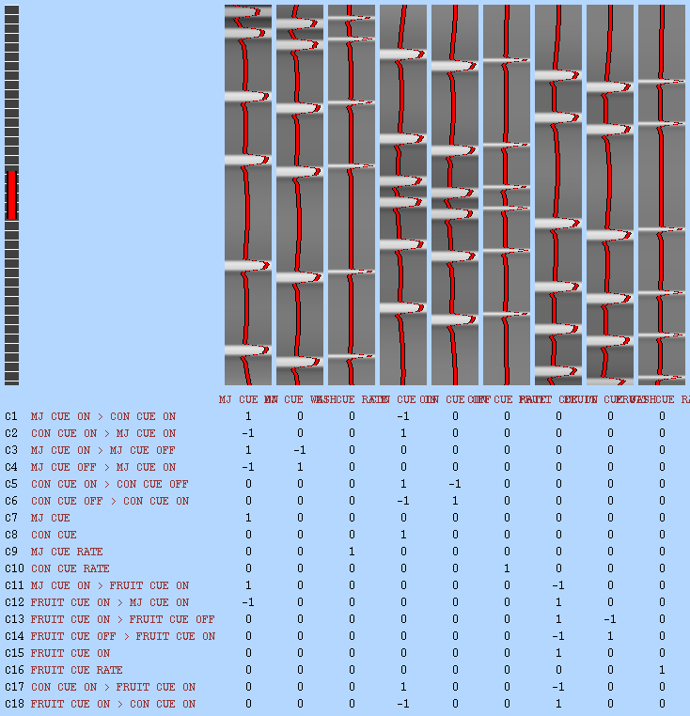

Slide 58
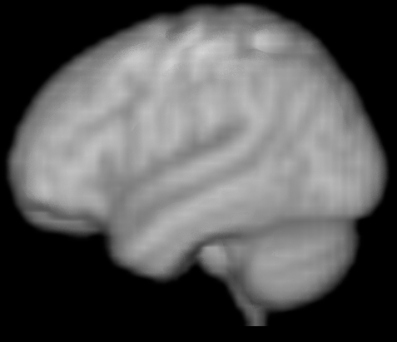

Slide 60
Subject 1

Slide 61

Subject 1

Slide 62
Subject 1

Slide 63
Subject 1

Slide 64
And so on

Slide 65
 |  |  |  |  |  |  | …
 |  |  |  |  |  |  | …
 |  |  |  |  |  |  | …
… | … | … | … | … | … | … | … | … | … | … | … | … | … | …
 |  |  |  |  |  |  | …
 |  |  |  |  |  |  | …
 |  |  |  |  |  |  | …

Slide 66
Subject 1’s Pipe > Fruit Contrast
 |  |  |  |  |  |  | …
 |  |  |  |  |  |  | …
 |  |  |  |  |  |  | …
… | … | … | … | … | … | … | … | … | … | … | … | … | … | …
 |  |  |  |  |  |  | …
 |  |  |  |  |  |  | …
 |  |  |  |  |  |  | …

Slide 67
Subject 2’s Pipe > Fruit Contrast
 |  |  |  |  |  |  | …
 |  |  |  |  |  |  | …
 |  |  |  |  |  |  | …
… | … | … | … | … | … | … | … | … | … | … | … | … | … | …
 |  |  |  |  |  |  | …
 |  |  |  |  |  |  | …
 |  |  |  |  |  |  | …

Slide 68
Subject 3’s Pipe > Fruit Contrast
 |  |  |  |  |  |  | …
 |  |  |  |  |  |  | …
 |  |  |  |  |  |  | …
… | … | … | … | … | … | … | … | … | … | … | … | … | … | …
 |  |  |  |  |  |  | …
 |  |  |  |  |  |  | …
 |  |  |  |  |  |  | …

Slide 69
And so on

Slide 70
 |  |  |  |  |  |  | …
 |  |  |  |  |  |  | …
 |  |  |  |  |  |  | …
… | … | … | … | … | … | … | … | … | … | … | … | … | … | …
 |  |  |  |  |  |  | …
 |  |  |  |  |  |  | …
 |  |  |  |  |  |  | …
Subject 128’s Pipe > Fruit Contrast

Slide 71
 |  |  |  |  |  |  | …
 |  |  |  |  |  |  | …
 |  |  |  |  |  |  | …
… | … | … | … | … | … | … | … | … | … | … | … | … | … | …
 |  |  |  |  |  |  | …
 |  |  |  |  |  |  | …
 |  |  |  |  |  |  | …
Voxels
Contrast Data (Brains)

Slide 72
1 | 0 | 1 | 0 | 1 | 0 | 9 | 9
1 | 0 | 1 | 0 | 0 | 1 | 9 | 5
1 | 0 | 0 | 1 | 1 | 0 | 7 | 6
0 | 1 | 0 | 1 | 1 | 0 | 2 | 5
0 | 1 | 0 | 1 | 0 | 1 | 2 | 6
0 | 1 | 0 | 1 | 0 | 1 | 3 | 2
 |  |  |  |  |  |  | …
 |  |  |  |  |  |  | …
 |  |  |  |  |  |  | …
… | … | … | … | … | … | … | … | … | … | … | … | … | … | …
 |  |  |  |  |  |  | …
 |  |  |  |  |  |  | …
 |  |  |  |  |  |  | …
Voxels
Groups, Genes, and Stress
Contrast Data (Brains)

Slide 73
Group assignment: MJ group
1 | 0 | 1 | 0 | 1 | 0 | 9 | 9
1 | 0 | 1 | 0 | 0 | 1 | 9 | 5
1 | 0 | 0 | 1 | 1 | 0 | 7 | 6
0 | 1 | 0 | 1 | 1 | 0 | 2 | 5
0 | 1 | 0 | 1 | 0 | 1 | 2 | 6
0 | 1 | 0 | 1 | 0 | 1 | 3 | 2
 |  |  |  |  |  |  | …
 |  |  |  |  |  |  | …
 |  |  |  |  |  |  | …
… | … | … | … | … | … | … | … | … | … | … | … | … | … | …
 |  |  |  |  |  |  | …
 |  |  |  |  |  |  | …
 |  |  |  |  |  |  | …
Voxels
Groups, Genes, and Stress
Contrast Data (Brains)

Slide 74
Group assignment: CON group
1 | 0 | 1 | 0 | 1 | 0 | 9 | 9
1 | 0 | 1 | 0 | 0 | 1 | 9 | 5
1 | 0 | 0 | 1 | 1 | 0 | 7 | 6
0 | 1 | 0 | 1 | 1 | 0 | 2 | 5
0 | 1 | 0 | 1 | 0 | 1 | 2 | 6
0 | 1 | 0 | 1 | 0 | 1 | 3 | 2
 |  |  |  |  |  |  | …
 |  |  |  |  |  |  | …
 |  |  |  |  |  |  | …
… | … | … | … | … | … | … | … | … | … | … | … | … | … | …
 |  |  |  |  |  |  | …
 |  |  |  |  |  |  | …
 |  |  |  |  |  |  | …
Voxels
Groups, Genes, and Stress
Contrast Data (Brains)

Slide 75
FAAH Gene
1 | 0 | 1 | 0 | 1 | 0 | 9 | 9
1 | 0 | 1 | 0 | 0 | 1 | 9 | 5
1 | 0 | 0 | 1 | 1 | 0 | 7 | 6
0 | 1 | 0 | 1 | 1 | 0 | 2 | 5
0 | 1 | 0 | 1 | 0 | 1 | 2 | 6
0 | 1 | 0 | 1 | 0 | 1 | 3 | 2
 |  |  |  |  |  |  | …
 |  |  |  |  |  |  | …
 |  |  |  |  |  |  | …
… | … | … | … | … | … | … | … | … | … | … | … | … | … | …
 |  |  |  |  |  |  | …
 |  |  |  |  |  |  | …
 |  |  |  |  |  |  | …
Voxels
Groups, Genes, and Stress
Contrast Data (Brains)

Slide 76
CNR1 Gene
1 | 0 | 1 | 0 | 1 | 0 | 9 | 9
1 | 0 | 1 | 0 | 0 | 1 | 9 | 5
1 | 0 | 0 | 1 | 1 | 0 | 7 | 6
0 | 1 | 0 | 1 | 1 | 0 | 2 | 5
0 | 1 | 0 | 1 | 0 | 1 | 2 | 6
0 | 1 | 0 | 1 | 0 | 1 | 3 | 2
 |  |  |  |  |  |  | …
 |  |  |  |  |  |  | …
 |  |  |  |  |  |  | …
… | … | … | … | … | … | … | … | … | … | … | … | … | … | …
 |  |  |  |  |  |  | …
 |  |  |  |  |  |  | …
 |  |  |  |  |  |  | …
Voxels
Groups, Genes, and Stress
Contrast Data (Brains)

Slide 77
Early (Childhood) Stress
1 | 0 | 1 | 0 | 1 | 0 | 9 | 9
1 | 0 | 1 | 0 | 0 | 1 | 9 | 5
1 | 0 | 0 | 1 | 1 | 0 | 7 | 6
0 | 1 | 0 | 1 | 1 | 0 | 2 | 5
0 | 1 | 0 | 1 | 0 | 1 | 2 | 6
0 | 1 | 0 | 1 | 0 | 1 | 3 | 2
 |  |  |  |  |  |  | …
 |  |  |  |  |  |  | …
 |  |  |  |  |  |  | …
… | … | … | … | … | … | … | … | … | … | … | … | … | … | …
 |  |  |  |  |  |  | …
 |  |  |  |  |  |  | …
 |  |  |  |  |  |  | …
Voxels
Groups, Genes, and Stress
Contrast Data (Brains)

Slide 78
Perceived (current) Stress
1 | 0 | 1 | 0 | 1 | 0 | 9 | 9
1 | 0 | 1 | 0 | 0 | 1 | 9 | 5
1 | 0 | 0 | 1 | 1 | 0 | 7 | 6
0 | 1 | 0 | 1 | 1 | 0 | 2 | 5
0 | 1 | 0 | 1 | 0 | 1 | 2 | 6
0 | 1 | 0 | 1 | 0 | 1 | 3 | 2
 |  |  |  |  |  |  | …
 |  |  |  |  |  |  | …
 |  |  |  |  |  |  | …
… | … | … | … | … | … | … | … | … | … | … | … | … | … | …
 |  |  |  |  |  |  | …
 |  |  |  |  |  |  | …
 |  |  |  |  |  |  | …
Voxels
Groups, Genes, and Stress
Contrast Data (Brains)

Slide 79
 |  |  |  |  |  |  | …
 |  |  |  |  |  |  | …
 |  |  |  |  |  |  | …
… | … | … | … | … | … | … | … | … | … | … | … | … | … | …
 |  |  |  |  |  |  | …
 |  |  |  |  |  |  | …
 |  |  |  |  |  |  | …
Voxels
Groups, Genes, and Stress
Contrast Data (Brains)

Slide 80
Group: 1 Variable that spans 2 columns
 |  |  |  |  |  |  | …
 |  |  |  |  |  |  | …
 |  |  |  |  |  |  | …
… | … | … | … | … | … | … | … | … | … | … | … | … | … | …
 |  |  |  |  |  |  | …
 |  |  |  |  |  |  | …
 |  |  |  |  |  |  | …
Voxels
Groups, Genes, and Stress
Contrast Data (Brains)

Slide 81
FAAH: 1 Variable that spans 2 columns
 |  |  |  |  |  |  | …
 |  |  |  |  |  |  | …
 |  |  |  |  |  |  | …
… | … | … | … | … | … | … | … | … | … | … | … | … | … | …
 |  |  |  |  |  |  | …
 |  |  |  |  |  |  | …
 |  |  |  |  |  |  | …
Voxels
Groups, Genes, and Stress
Contrast Data (Brains)

Slide 82
CNR1: 1 Variable that spans 2 columns
 |  |  |  |  |  |  | …
 |  |  |  |  |  |  | …
 |  |  |  |  |  |  | …
… | … | … | … | … | … | … | … | … | … | … | … | … | … | …
 |  |  |  |  |  |  | …
 |  |  |  |  |  |  | …
 |  |  |  |  |  |  | …
Voxels
Groups, Genes, and Stress
Contrast Data (Brains)

Slide 83
Early stress: 1 Variable that spans 1 column
 |  |  |  |  |  |  | …
 |  |  |  |  |  |  | …
 |  |  |  |  |  |  | …
… | … | … | … | … | … | … | … | … | … | … | … | … | … | …
 |  |  |  |  |  |  | …
 |  |  |  |  |  |  | …
 |  |  |  |  |  |  | …
Voxels
Groups, Genes, and Stress
Contrast Data (Brains)

Slide 84
Perceived Stress: 1 Variable that spans 1 column
 |  |  |  |  |  |  | …
 |  |  |  |  |  |  | …
 |  |  |  |  |  |  | …
… | … | … | … | … | … | … | … | … | … | … | … | … | … | …
 |  |  |  |  |  |  | …
 |  |  |  |  |  |  | …
 |  |  |  |  |  |  | …
Voxels
Groups, Genes, and Stress
Contrast Data (Brains)

Slide 85
Five total variables
 |  |  |  |  |  |  | …
 |  |  |  |  |  |  | …
 |  |  |  |  |  |  | …
… | … | … | … | … | … | … | … | … | … | … | … | … | … | …
 |  |  |  |  |  |  | …
 |  |  |  |  |  |  | …
 |  |  |  |  |  |  | …
Voxels
Groups, Genes, and Stress
Contrast Data (Brains)

Slide 86
Pause
This set up is analogous to—but not the same as—group (second) level
We’re using a contrast per person
With explanatory variables
Instead of mass-univariate we’ll do PLS!

Slide 87
PLS Magic

Slide 88
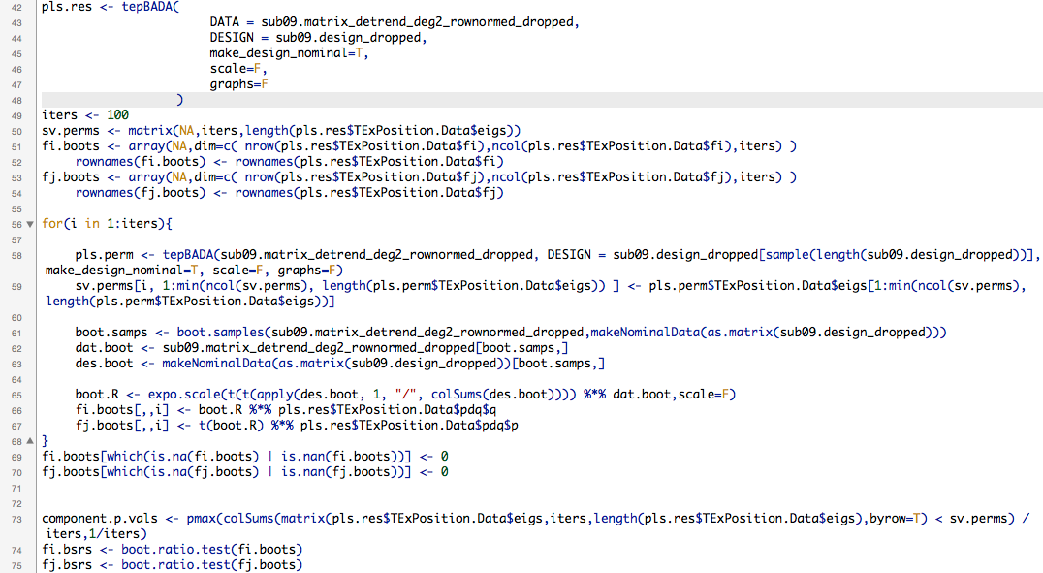

Slide 89
That’s it
Exact same code as before
Only difference is how we read in brain data and store it
One person at a time and save it in a matrix.

Slide 90
Results

Slide 91
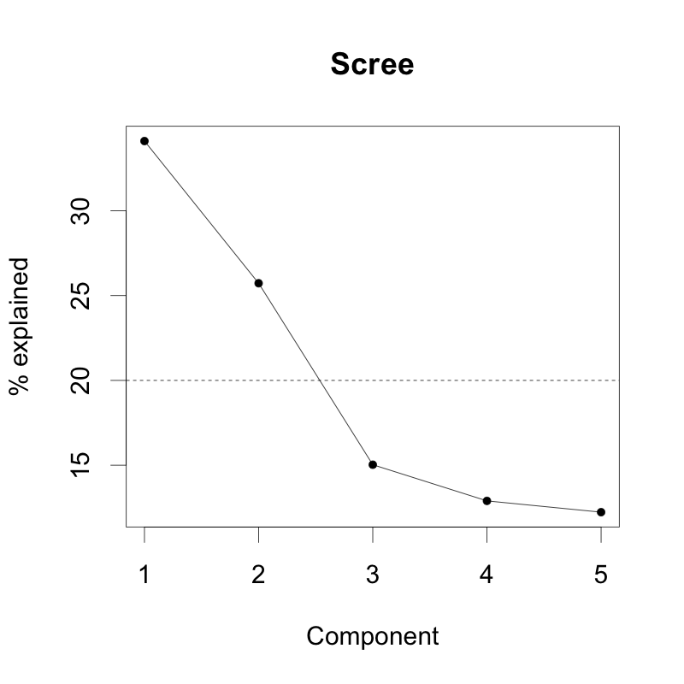

Slide 92
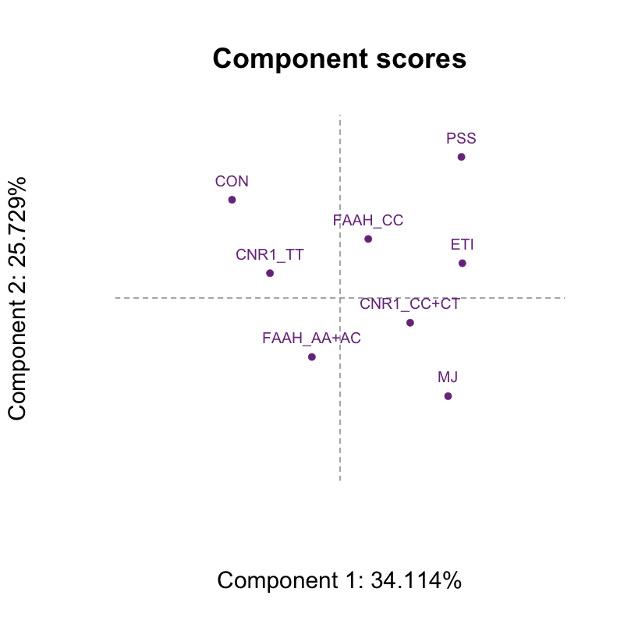

Slide 93
Let’s just focus on LV1

Slide 94
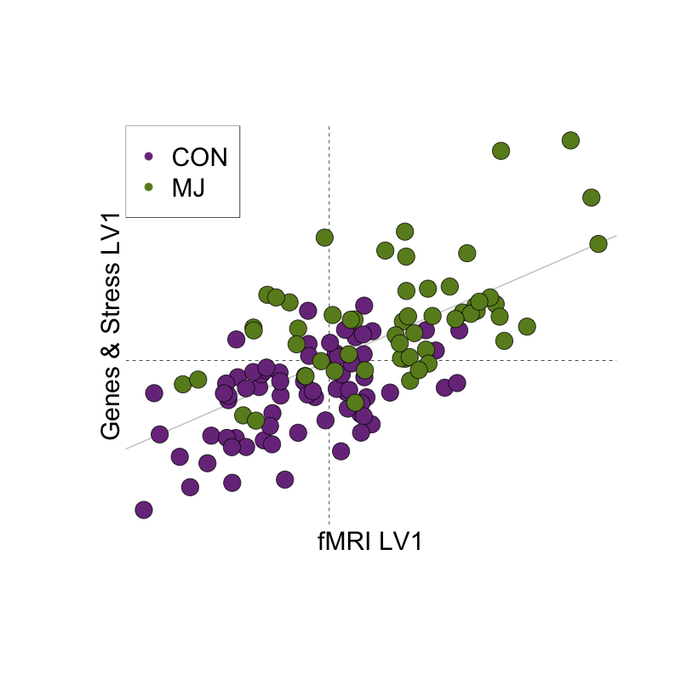
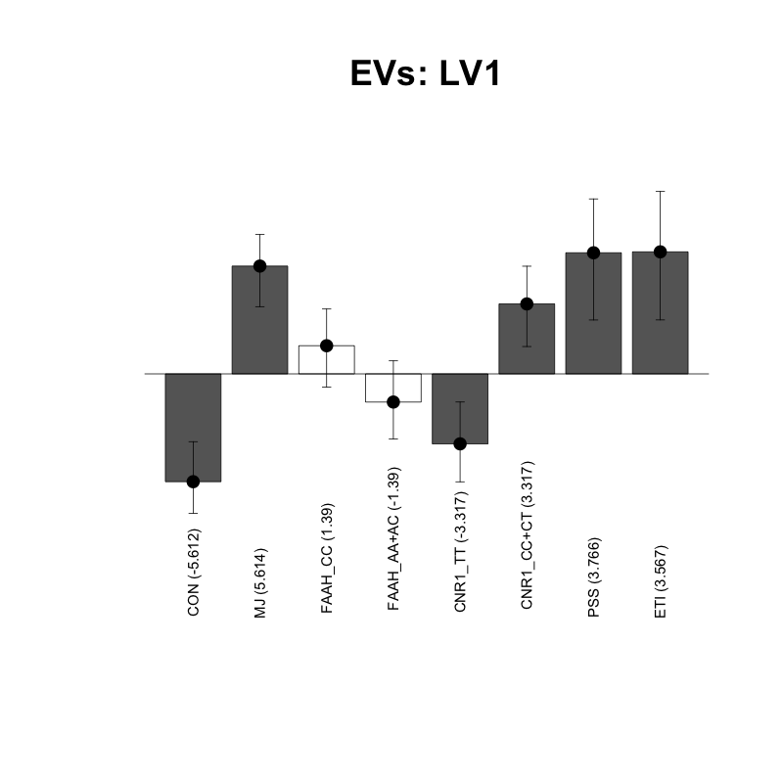

Slide 95
MJ, CNR1 CC/CT, PSS, ETI

Slide 96
MJ, CNR1 CC/CT, PSS, ETI
CON, CNR1 TT

Slide 97
MJ, CNR1 CC/CT, PSS, ETI

Slide 98
MJ, CNR1 CC/CT, PSS, ETI
NOTE:
Brain bootstrap ratios exported then visualized in Mango

Slide 99
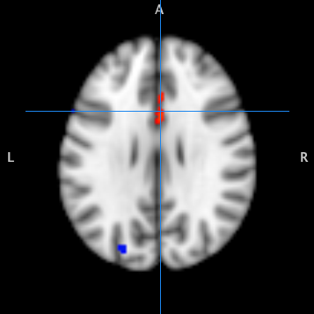
MJ, CNR1 CC/CT, PSS, ETI
CINGULATE GYRUS

Slide 100
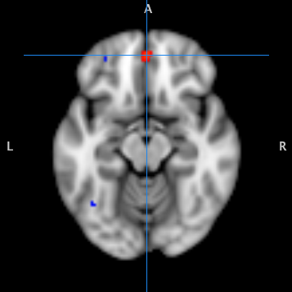
MJ, CNR1 CC/CT, PSS, ETI
MEDIAL FRONTAL GYRUS

Slide 101
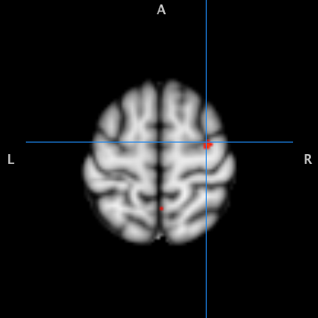
MJ, CNR1 CC/CT, PSS, ETI
PRECENTRAL GYRUS

Slide 102
CON, CNR1 TT

Slide 103

CON, CNR1 TT
INF. OCCIPITAL GYRUS

Slide 104

CON, CNR1 TT
INF. OCCIPITAL GYRUS
SUP. TEMPORAL GYRUS

Slide 105

CON, CNR1 TT
INF. OCCIPITAL GYRUS
INSULA

Slide 106
R PLS Summary
From a complex design we used some tricks to provide a straightforward analysis to address research questions
Code is exactly the same as in the single-subject baby example

Slide 107
To wrapup
You can use PLS in many ways to approach your research questions
Tools available in Matlab and (rapidly increasingly) in R
If you like R, come talk to us!

Slide 108
Suggested Readings
Krishnan et al., (2011)
McIntosh & Lobaugh (2004)
McIntosh & Misic (2013)
Abdi & William (2010) - PCA

Slide 109
Fin
Questions?
Comments?
Complaints?

